Slide 1
DealerTrack
Service Operations
- Incident Management
- Problem Management
Lewis Stockford
02/16/2015

Slide 2
Agenda
Problem Statement
Success Factors

Slide 3
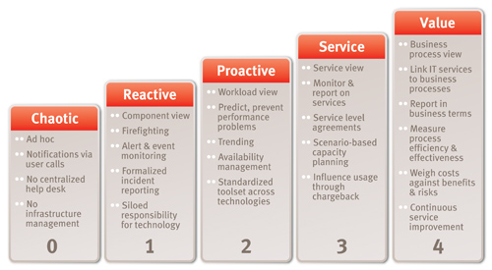
Problem Statement
Process
Incident Management Process and Tools are Immature or non-existent.
Problem Management Process and Tools are Immature or non-existent.
People
The people are not in place to manage IM/PM process

Slide 4
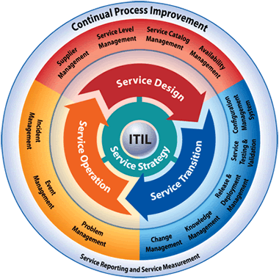
Continual Process Improvement
Incident management (JIRA)
Incident Communication
xMatters\Jira Integration
Problem Management
(JIRA)
Change Management
(JIRA)

Slide 5
Required Components for Success
Process
Tools
Success
People
Components Required for Success
Process
There are limited Incident Management processes in place
There are limited Problem Management processes in place
There are disparate Process/Functional Tools
People
There are no dedicated Process Experts
There are no dedicated Process Management Admins.

Slide 6

Roadmap
Service Desk Rollout
2015
Q4
Incident management Rollout
Problem Management Rollout
Change Management Improvements
Jira/xMatters Integration Rollout
Jira/Salesforce Integration Rollout
CMDB Discovery Integration
2015
Q3
2015
Q2
2015
Q1
Service Desk Requirements
Service Desk -
Construct

Slide 7
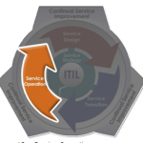
Service Operations – Phase 1
Service Operation is where the value of the services being provided is first realized by the customer.
Incident Management
Restore Service ASAP
Problem Management
identify Root Cause of the incident(s)

Slide 8
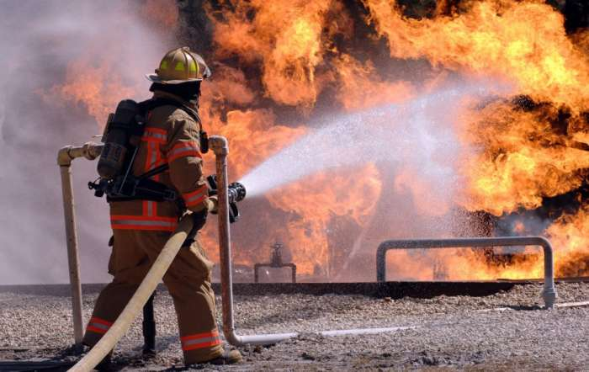
Incident Management
Incident is an unplanned interruption to an IT Service or a reduction in quality of an IT service. Failure of a Configuration Item that has not yet impacted the service is also an incident. For Example failure of one disk from a mirror set is also an incident
Incident Management is the process responsible for managing the lifecycle of all incidents. Primary Objective of Incident Management is to restore business or services as soon as possible and eventually bring down the Mean Time to Repair (MTTR)

Slide 9




Incident Response & Lifecycle
Log Incident
Detection, Analysis, External Communication
Remediation & Fix
Post-Incident Activities
User logs an Incident into Jira
Efficient communication platform for critical Incidents through xMatters integration
Assign an Incident Report subtask to generate Incident Report
Support Team from Salesforce reports an Outage\Incident into Jira
Assign additional action items on an Incident through subtask
Generate a word output of the incident Report through Jira
Log timeline of events with description on an incident
Create problem ticket through an Incident on a single click and assign to someone
Incident workflow to manage the ticket lifecycle

Slide 10
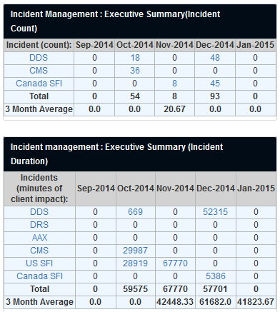
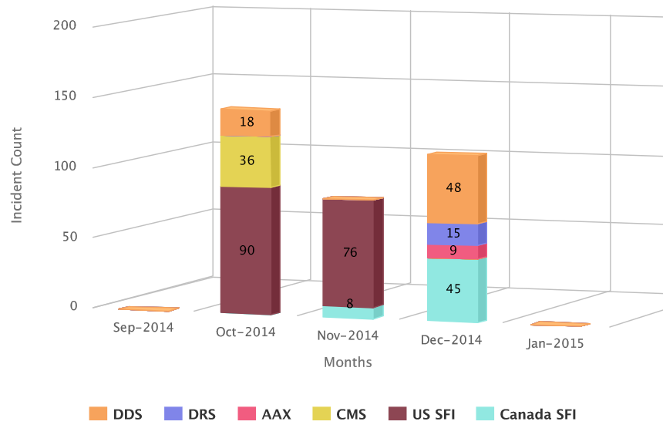
Incident Monitoring
Incident Dashboard for effective reporting for different roles
Track the progress on the Incident Reports assigned to a user

Slide 11
Demo
Incident Management
Incident
Incident Lifecycle
Incident Report
Integration
Salesforce
xMatters
Dashboard Views
NOC
Level 1
Level 2
Management
Executive Summary

Slide 12
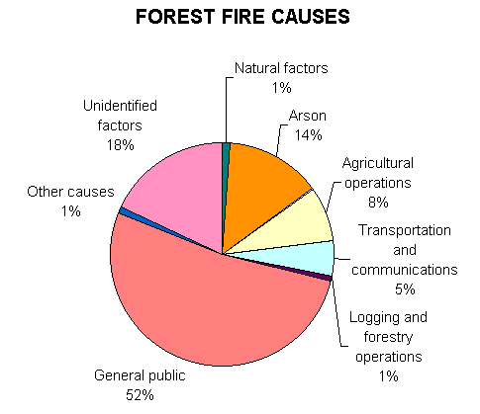

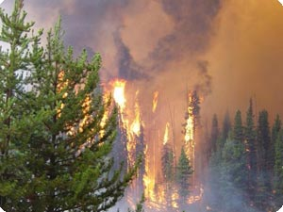
Problem Management
Problem Management is the process responsible for managing full lifecycle of all Problems. The Primary objective of Problem Management is to prevent problems and resulting incidents from happening, and to minimize the impact of incidents that cannot be prevented.
Root Cause Analysis (RCA) is a formal and critical component of Problem Management process. After a problem (or potential problem) is identified the root cause analysis begins to understand the problem and cause thoroughly and eliminate the cause from the environment or mitigate the risk of recurrence.
In the example of a forest fire, after we work hard to put out the fire it is important to do a root cause analysis and identify why the fire started. We look for trends and analyze the causes of all of the different fires. We then try to eliminate the root cause or reduce the chances of the event from happening again.

Slide 13
Problem Response & Lifecycle
Report a Problem
Detection & Analysis
Fix
Post-Problem Activities & Root Cause Analysis
User logs a Problem into Jira
Assign additional action items on an Problem through subtask
Assign RCA Report subtask to generate RCA Report
A Problem is automatically created through an Incident
Problem workflow to manage the ticket lifecycle
Generate a word output of the RCA Report through Jira

Slide 14
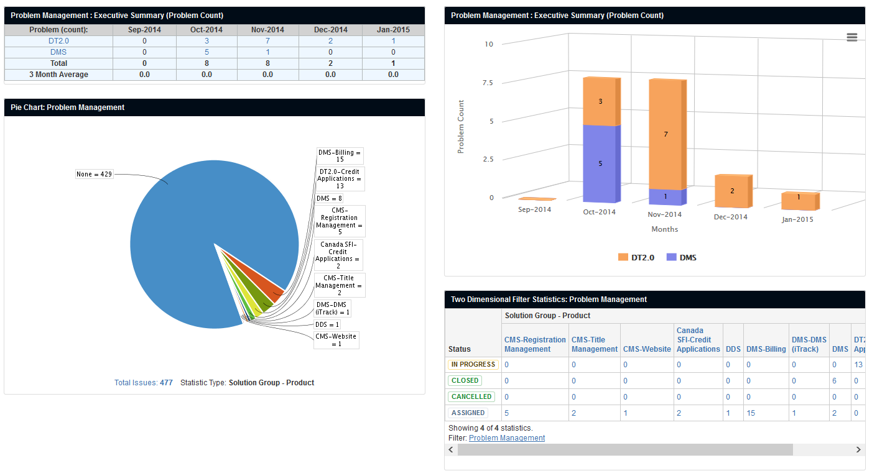
Problem Monitoring
Problem Dashboard for effective reporting for different roles
Track the progress on the RCA Reports assigned to a user

